Slide 1
Interoperable Simulation and Gaming Sprint
Hexagon Geospatial

Slide 2
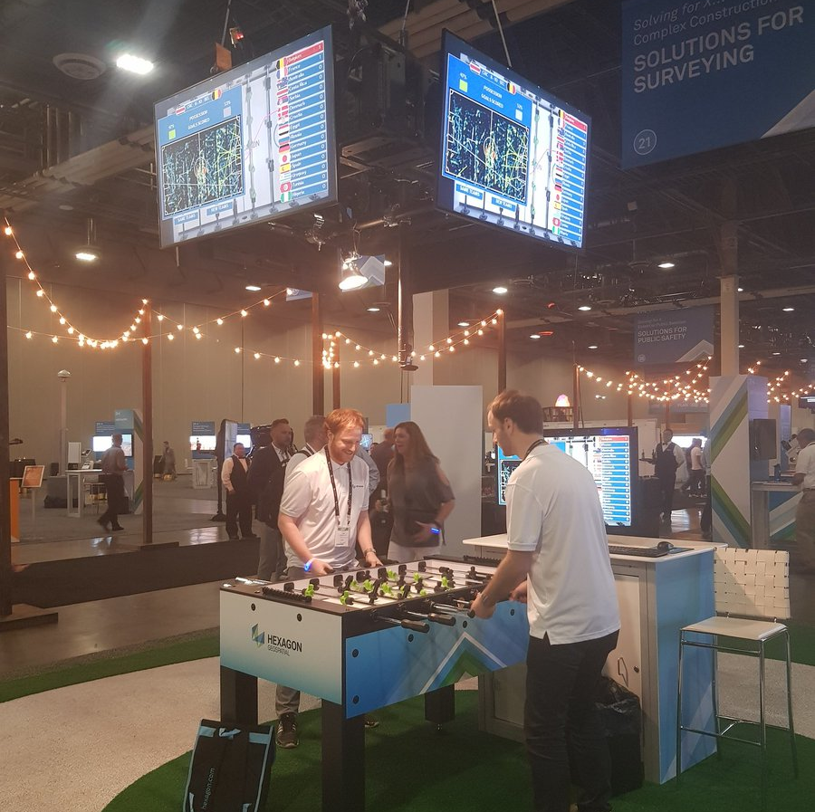

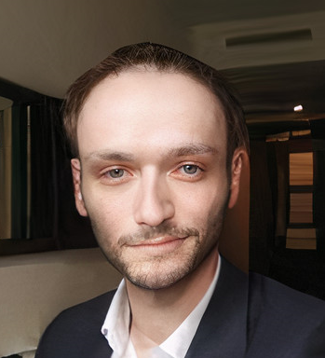
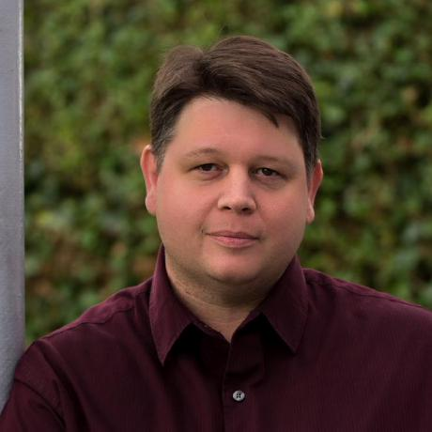
Technical Team
Tom Crauwels
Emeric Beaufays
Management
Frederic Houbie

Slide 3
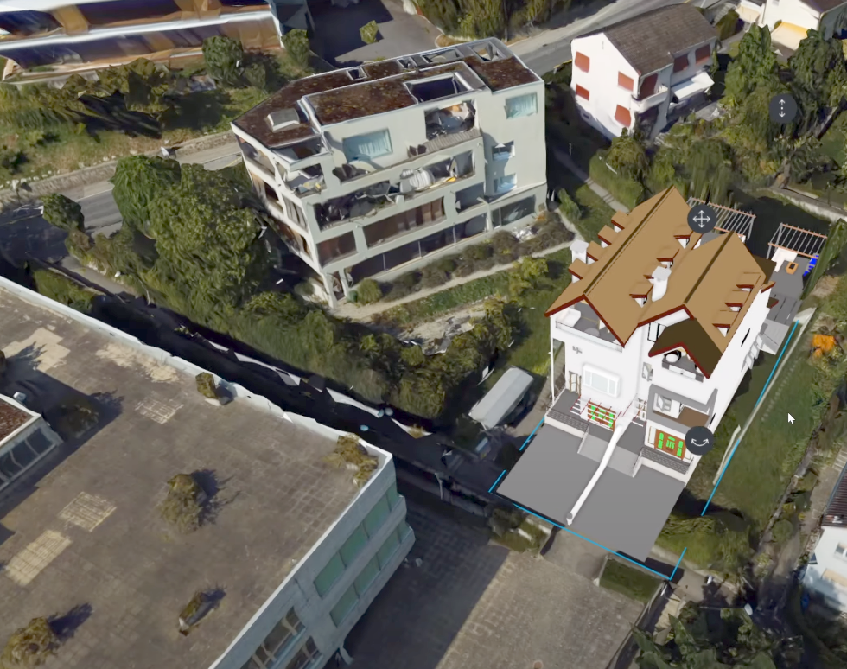
Scenarios
Scenario 1 : Investigate how model and terrain updates are integrated with 3D Tiles into the client environment.
Scenario 3 : What should be the organization of the underlying 3D data? (GeoVolumes)
Outside scope: Is re-tyling 3D data on the fly for increased performance feasible and useful?

Slide 4
Existing capabilities
Luciad Fusion:
(CDB) Data through OGC standards (WMS, WFS, OGC 3DTiles, ...)
3D Tiling engine (convert meshes to 3DTiles)
Luciad Ria:
3D Web-client

Slide 5
